Slide 1









PRESENTATION PROJECT ENGLISH
OOP
Project
Airline Management System

Slide 2
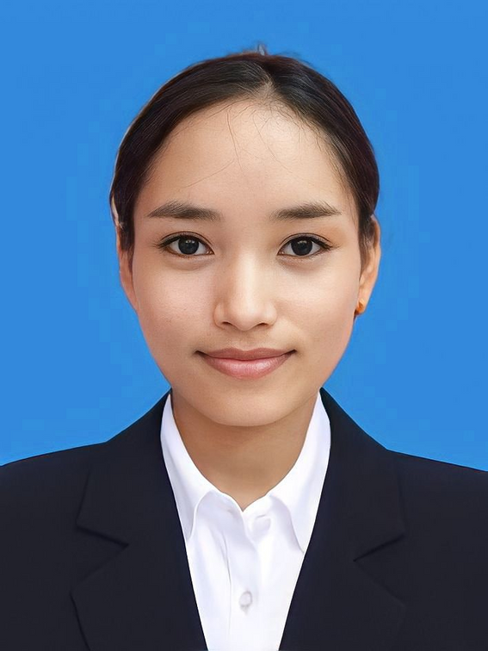
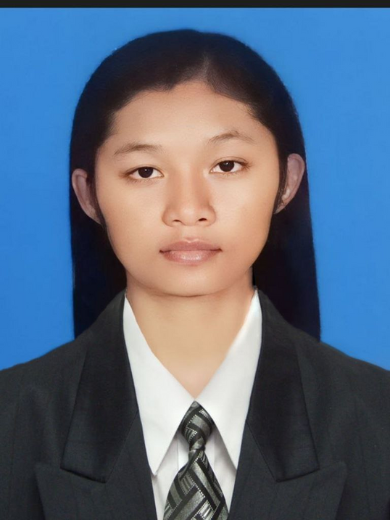
PRESENTATION PROJECT ENGLISH
AIRLINE MANAGEMENT SYSTEM
SOKNOEURN SRUN
SEANGENG ITH

Slide 3





TABLE OF CONTENTS
WHAT CAN OUR SYSTEM DO?
FIRST PART OF SYSTEM
SECOND PART OF SYSTEM
WHAT WE HAVE LEARNED
Roadmap
SEANGENG ITH

Slide 4


What can our system do?
Airport controller can get the details of the passenger
An airline can know how many passengers are booked on a return flight.
An airline chef can know how many meals they will prepare on a flight.
As an airline manager, I want to find out how much I pay all my employees.
As a passenger they can know which gate the plane is waiting at.
As an airline pilot how many flights he or she has to join
SEANGENG ITH

Slide 5
First part of our system
SEANGENG ITH

Slide 6
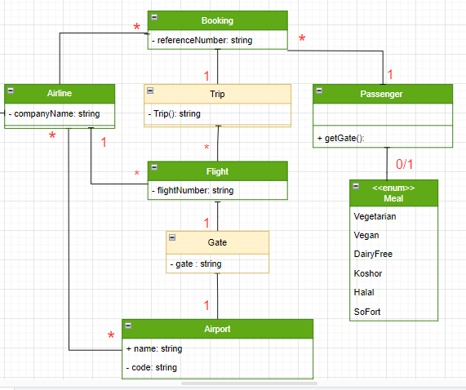
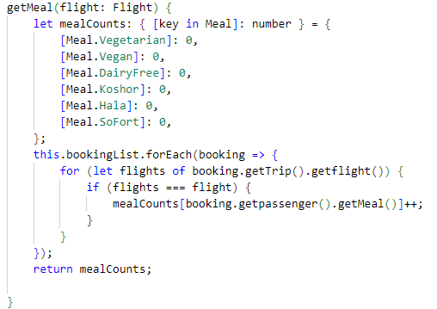
An airline chef can know how many meals they will prepare on a flight
SEANGENG ITH

Slide 7
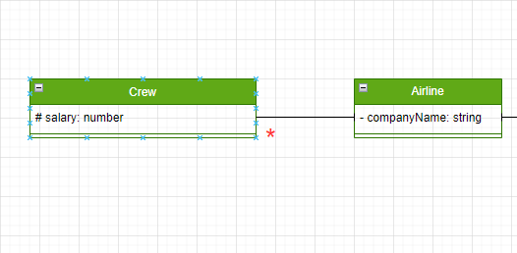
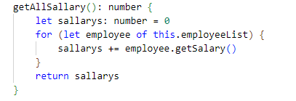
As an airline manager, I want to find out how much I pay all my employees
SEANGENG ITH

Slide 8
Second part of our system
SOKNOEURN SRUN

Slide 9
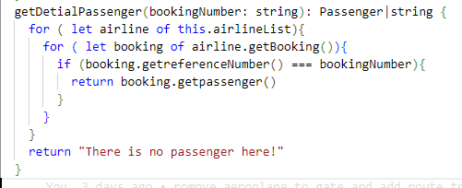
Airport controller can get the details of the passenger
SOKNOEURN SRUN

Slide 10
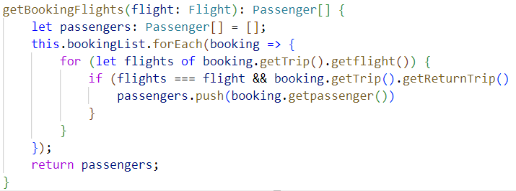
An airline can know how many passengers are booked on a return flight.
SOKNOEURN SRUN

Slide 11
What we have learned
SOKNOEURN SRUN

Slide 12
Hard Skill
Soft Skill
Data Analyzing
OOP Concept
Teamwork
Communication
Task&Time management
SOKNOEURN SRUN

Slide 13

Any Question?

